Slide 1
Stacks
A subset of a link list

Slide 2
Introduction
A stack and how it is implemented
A LIFO
The push (add node to stack)
pop functions (delete note from stack)
A queue and how it is implemented
A FIFO
The enqueue function (add node to queue)
Dequeue function (delete node from the queue)

Slide 3
The Stack Data Structures
A stack implemented using pointers?
Pop function off of the stack
Pointer to top of the stack : stackpointer
Function 2
Function 1
Function main
End of th stack contains a null value
Push function onto the stack
Pointer to position of previous frame address : frame pointer

Slide 4
12.5.3 Applications of Stacks
Stacks have many interesting applications.
For example, whenever a function call is made, the called function must know how to return to its caller, so the return address is pushed onto a stack.
If a series of function calls occurs, the successive return values are pushed onto the stack in last-in, first-out order so that each function can return to its caller.

Slide 5
A call Stack
A call stack is a data structure that is used to is used to store information about the active routines (functions) in a program.
Each time a function (main or other functions are invoked they, including local variables…) are pushed onto the stack.
Once the functions is finished executing “it” is popped from the stack.
A stack operates on the last in first out principle (LIFO) (push to beginning of the stack and pop from the beginning of the stack.
This procedure is controlled by the use of a stack pointer which keeps track of the “starting” position, sometimes referred to as the head/top, of the stack.

Slide 6
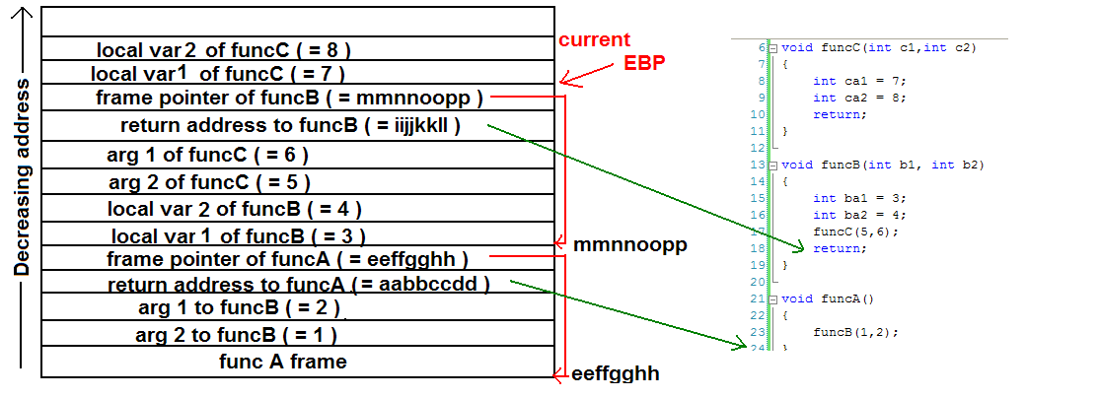
The Call stack
Example of call stack:
EBP: extended base pointer: aka frame pointer
ESP extended stack pointer: stack pointer

Slide 7
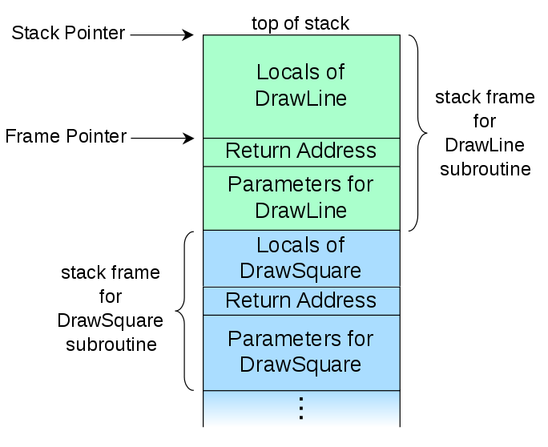
Call stack: Stack and Frame pointer
call stack Wikipedia

Slide 8
The Stack Data Structures
A stack implemented using pointers?
Pop function off of the stack
Pointer to top of the stack : stackpointer
Function 2
Function 1
Function main
End of th stack contains a null value
Push function onto the stack
Pointer to position of previous frame address : frame pointer

Slide 9
Implementation of a Stack:
stackPtr
3
2
1
Null
A stack is a series of connected nodes
Each node contains at least
A piece of data (e.g. P.C.B or functions)
Pointer to the next node in the stack ;
stackPtr: pointer to the first node
The last node points to NULL
stackPtr = Null indicates an empty stack

Slide 10
Create Node
Define node structure
struct stackNode {
int data; // define data as an int
struct stackNode *nextPtr; // stackNode pointer
};
typedef struct stackNode StackNode
Declare and create a node:
StackNode newPtr = malloc(sizeof(StackNode));
Assign value to StackNode fields
newPtr -> data = 4;
newPtr -> nextPtr = NULL;

Slide 11
Implementation of a stack
Two basic functions associated with stacks:
The push function: this adds a “node” to the beginning of a stack
The pop function: removes a “node” from the beginning of a non-empty stack.
Implementation is a combination of:
Creating a new node; (in C use malloc)
Assigning data to the data element of the node
Using the push function add a node to the stack
In the pop function you pop (delete) a node
The constrain that you can not pop from an empty stack.

Slide 12
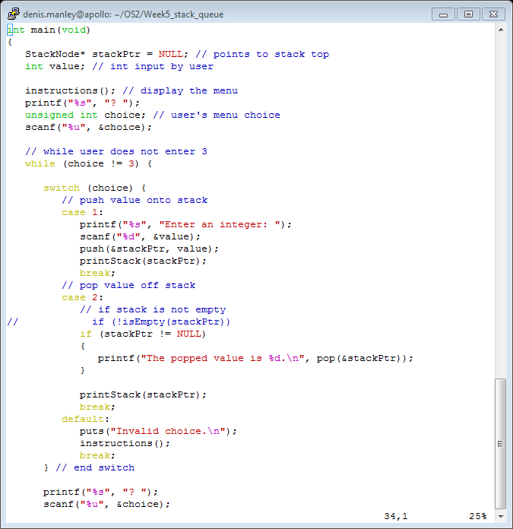
Main function Stack.c

Slide 13
The Function push
The function consists of three steps:
Create a new node using malloc and assign the location of the allocated memory to newPtr
Assign data, that is to be added to the stack,to the new node; Assign the pointer part of the new node to store the address in stackPtr; the address of the node that is currently top of the stack.
Move stackPtr to point to the new node. {assign address of new node to the stackPtr}

Slide 14
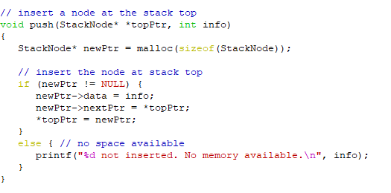
Sample code push function

Slide 15
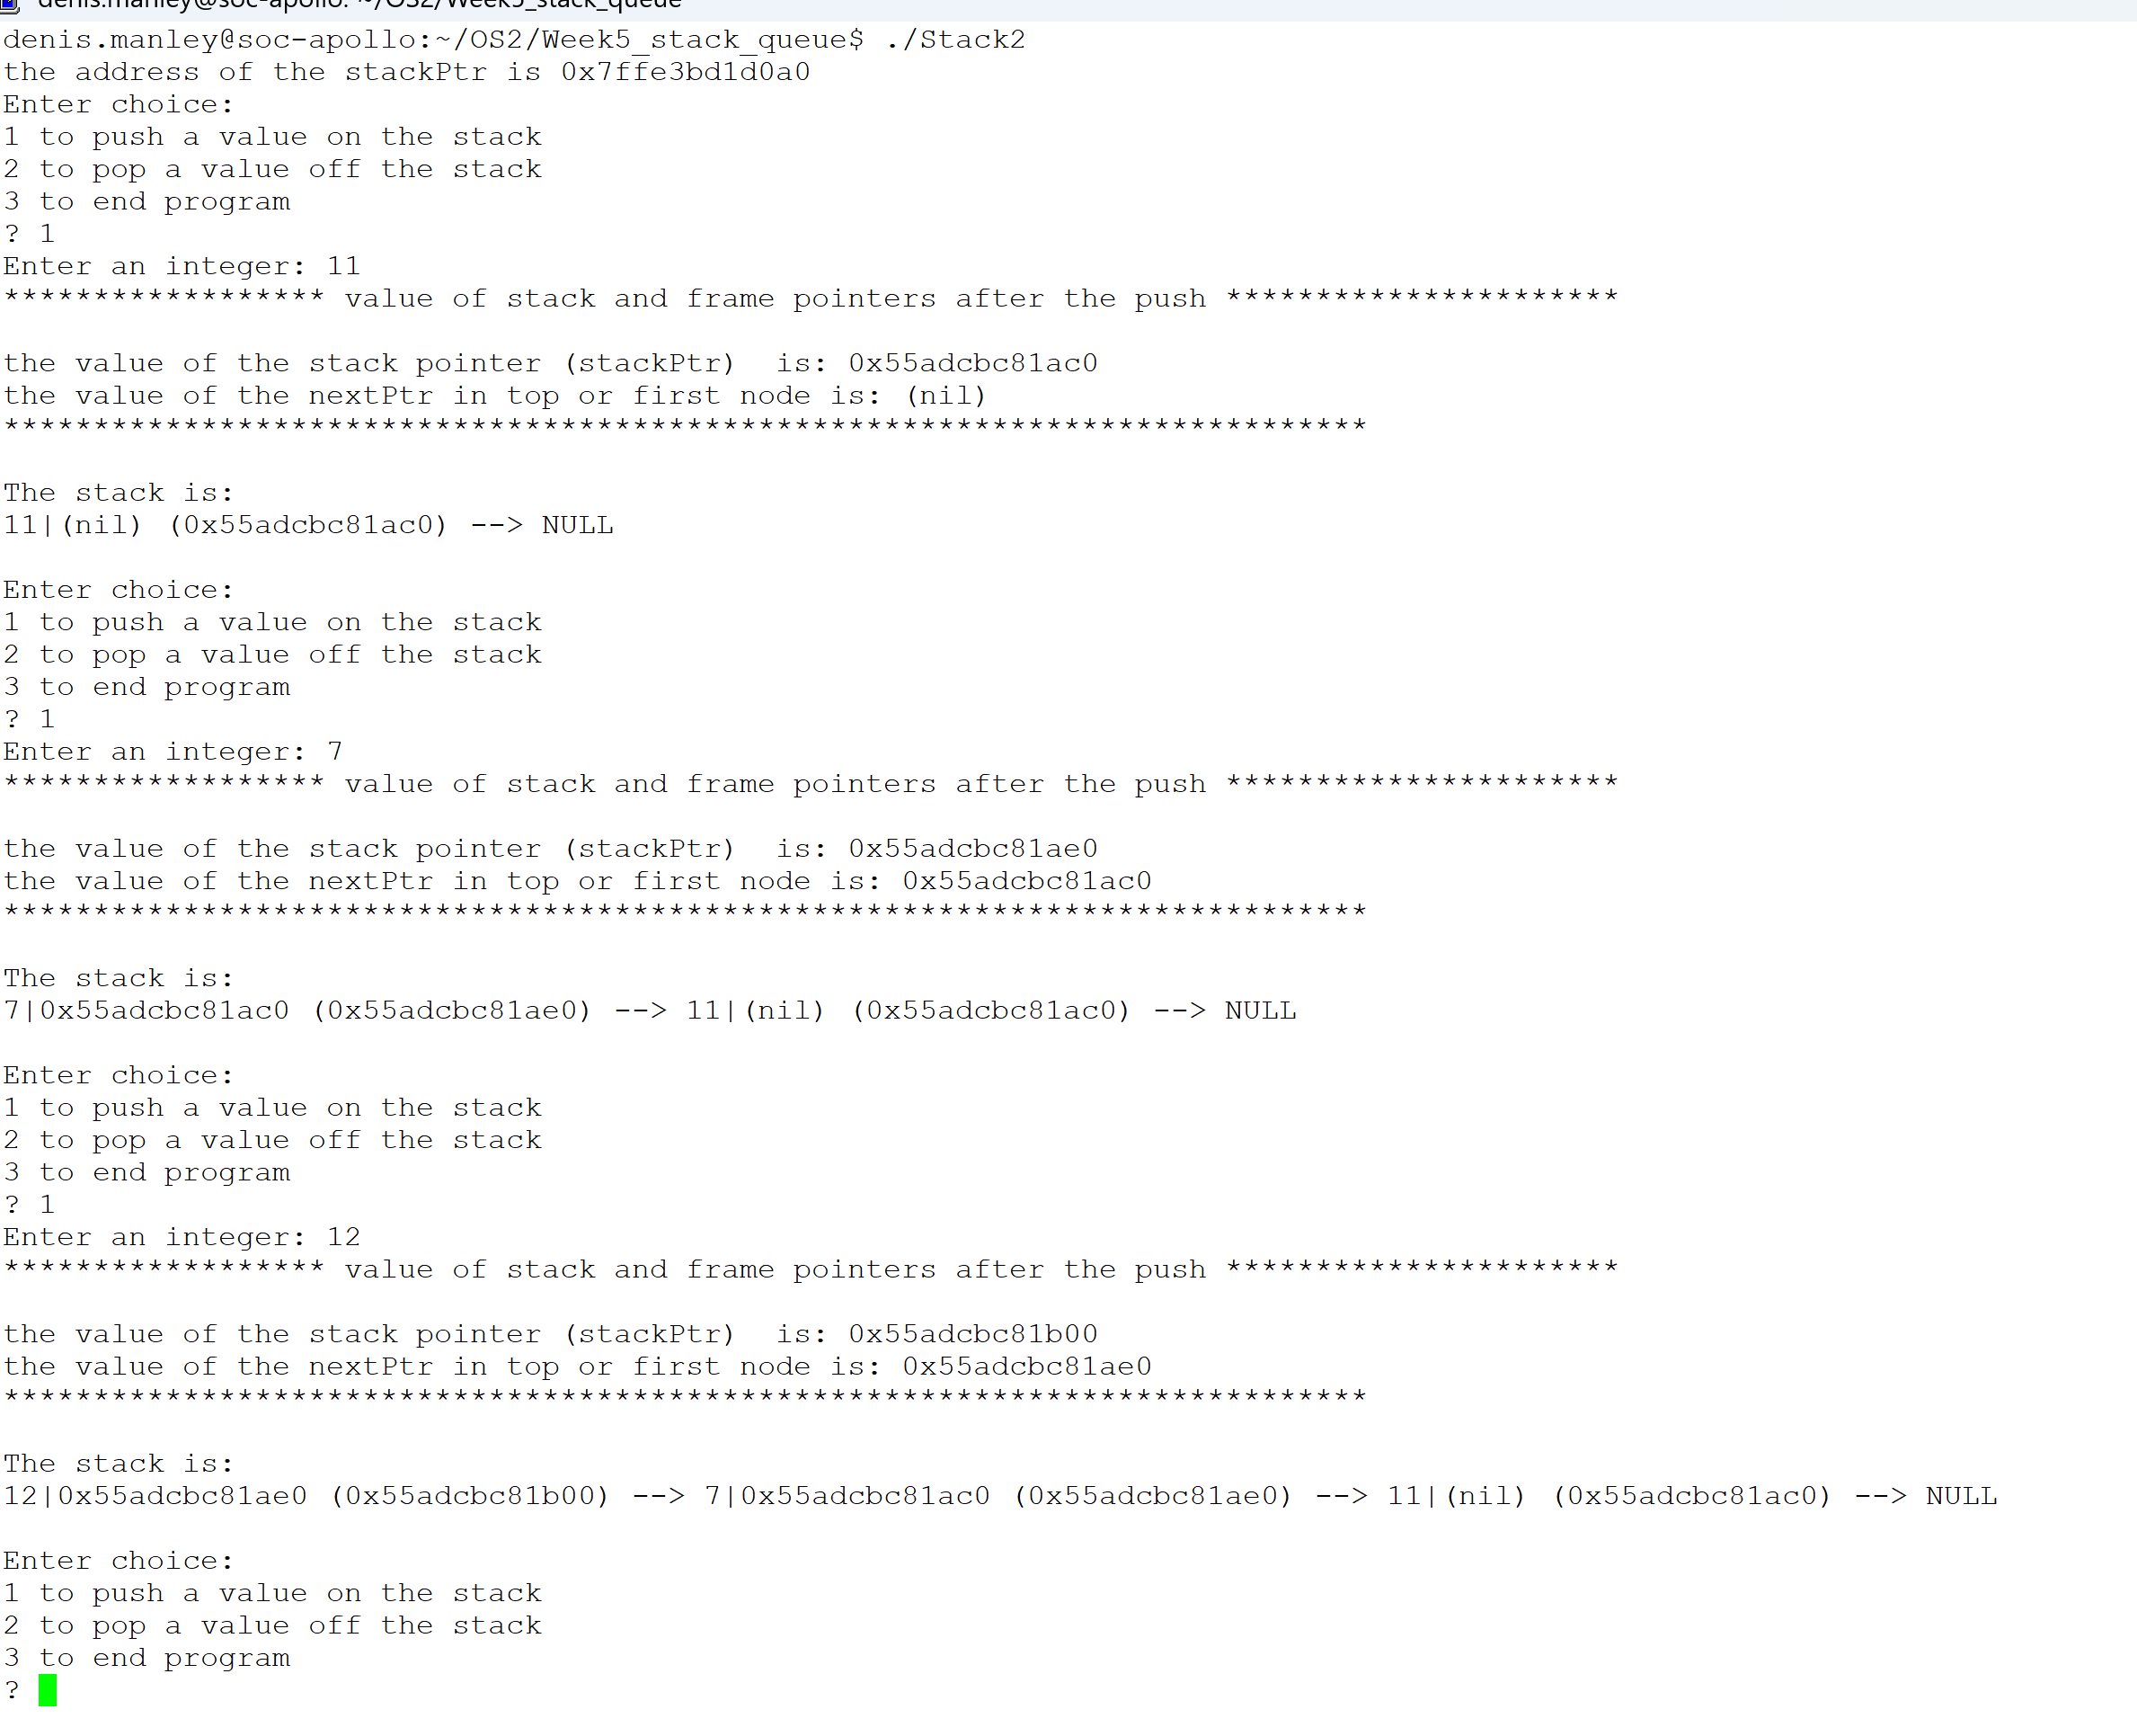
Add 3 nodes to empty stack: stack2.c

Slide 16
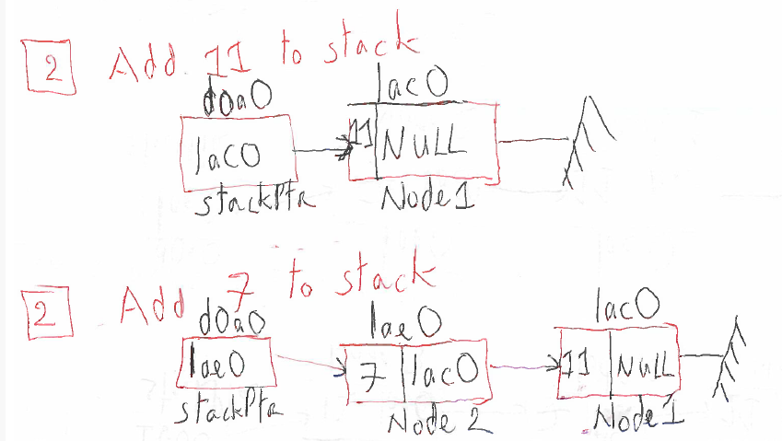
Push on to stack
Before and after: representation of stack

Slide 17
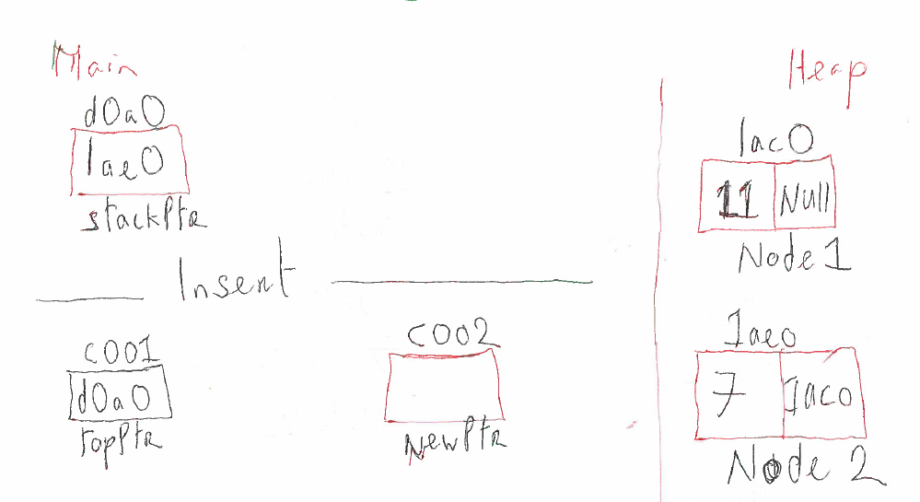
Illustration of push on to stack
Contents of memory locations of relevant variables: Before the push onto the stack. What happens when a new value 12 is pushed onto the stack: address of new node will be 1bb0

Slide 18
Delete/pop a node from the stack
The current stack containing two node
stackPrt
&c
C
&A
null
A
Y
C
stackPtr
&c
$A
A
null
C
Assign the data element of (top/first) node in the stack to a variable Y
Assign stackPtr pointer to point to second node in the stack.
Return data and delete node ( c )
stackPtr
&A
A
null

Slide 19
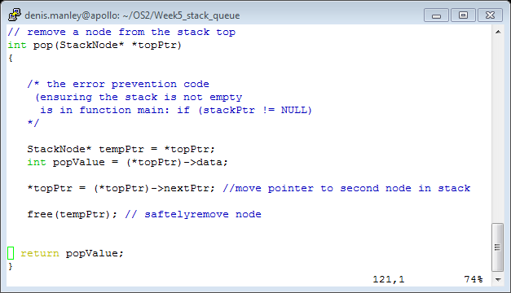
Sample code pop function

Slide 20
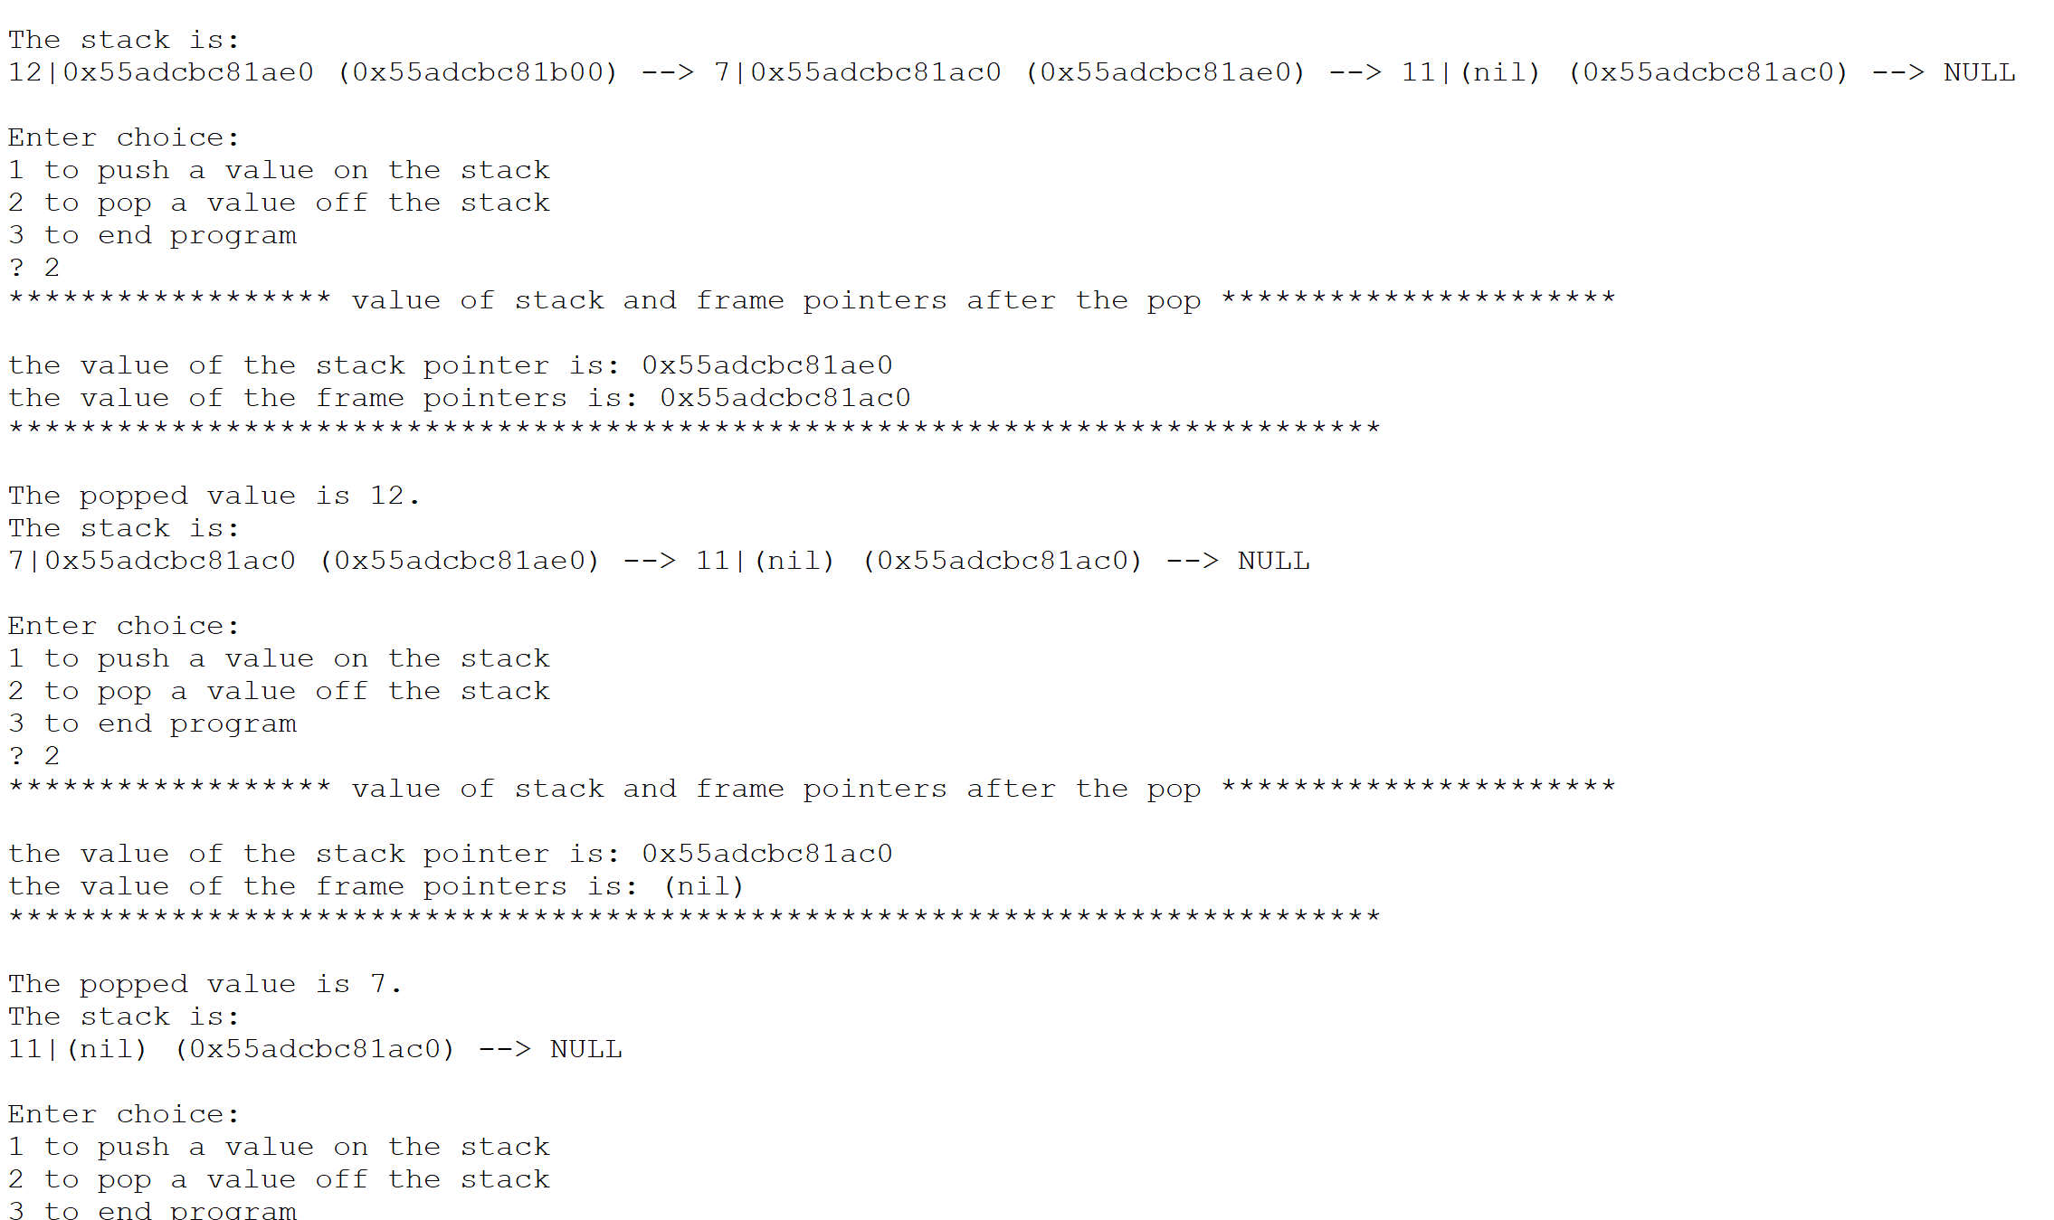
Popping 2 nodes from stack: Stack2.c

Slide 21
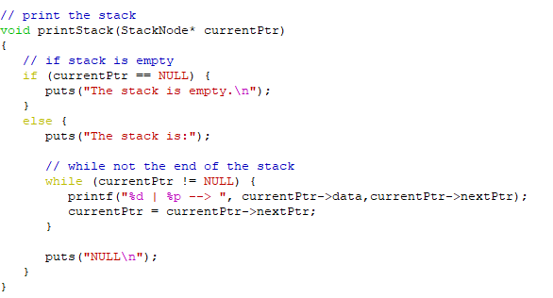
Print function:

Slide 22
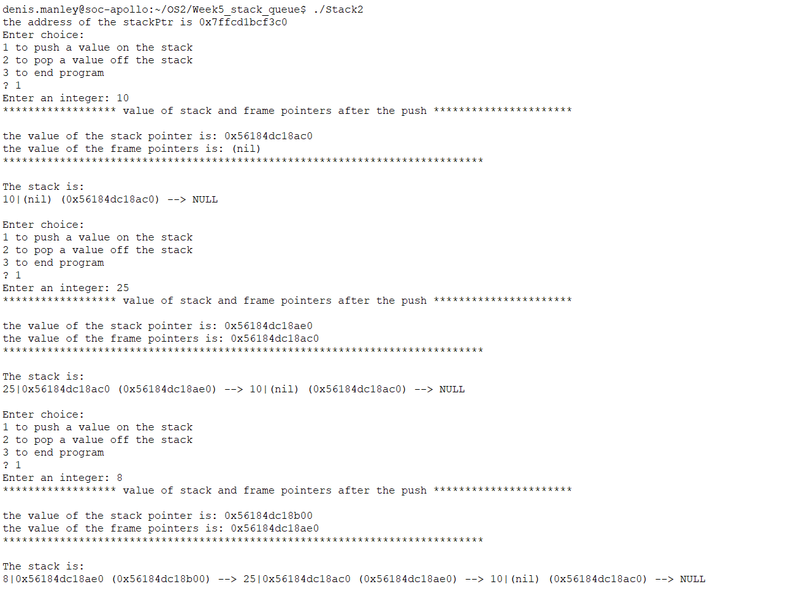
Home Work: Illustrate adding 3 nodes onto the stack
What is the value in stackPtr after a pop?

Slide 23
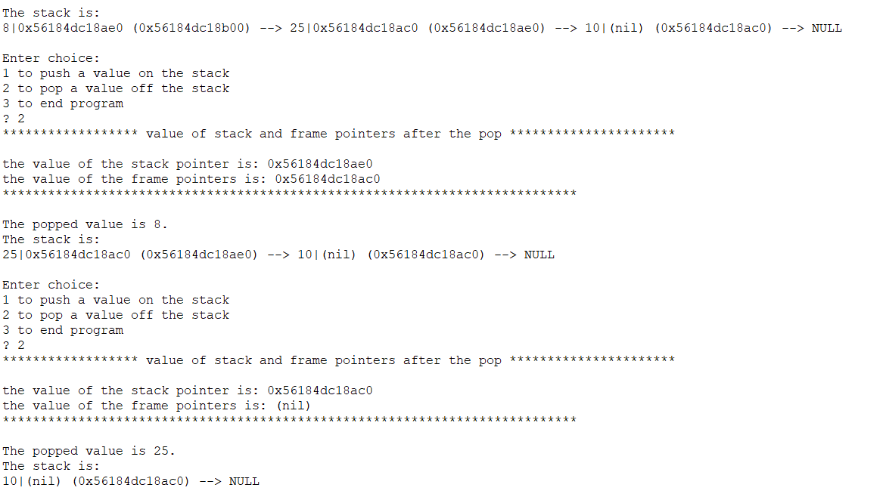
Home Work: The address after poping 2 nodes
answer

Slide 24
Sample Questions
Describe, using an example, what is the stack data structure and how/where it can be used in the execution of a program . (6 marks)
Describe, using examples, what is a queue data structure and give two examples of where it may used in operating systems. (6 marks)

Slide 25
Sample question
Explain, using examples (include node addresses), how to enqueue and dequeue nodes from of a queue (15 marks)
Explain, using examples (include node addresses), how to push and pop functions of a stack (15 marks)

Slide 26
Clearly explain, using an example, if this function will add a node on to the top of a stack : (you will need to explain all parts of the code) (10 marks)
//the fnt call // StackPtr is a pointer to the top of the stack data structure.
Push (&StackPtr);
void push(StackNode** topPtr, int info)
{
StackNode newPtr = malloc(sizeof(StackNode));
if (newPtr != NULL) {
newPtr->data = info;
newPtr->nextPtr = topPtr;
topPtr = newPtr;
}
else {
printf("%d not inserted. No memory available.\n", info);
}
}

Slide 27
Explain what the following code does and if it would correctly pop a value from the stack (10 Marks)
// function to pop values from stack assuming it is not empty
int pop(StackNode** topPtr)
{
if (topPtr != Null){
StackNode* tempPtr = topPtr;
int popValue = (*topPtr)->data;
topPtr = (*topPtr)->nextPtr;
free(tempPtr);
return popValue;
}
else return ‘\0’;

